Slide 1
Scissors, Paper Rock Game
By: Atullya Maharjan

Slide 2
Scissor, Paper Rock Game
Scissor Paper Rock (also known as Rock Paper Scissors) is a two-player game where each player simultaneously chooses one of three possible hand shapes (scissors, paper, or rock). Rock paper scissors is often used as a fair choosing method between two people, similar to coin flipping.The players' choices are then compared, and the winner is determined based on the following rules:
Scissors beats Paper: If both players choose scissors, the game is a draw.
Paper beats Rock: If both players choose paper, the game is a draw.
Rock beats Scissors: If both players choose rock, the game is a draw.
The game is quick, easy to learn, and does not require any special equipment. It is often used as a way to settle disputes or make decisions in a variety of situations, as it is a simple game of chance.

Slide 3
Objectives
To create an interactive computer game in C++ that allows two players to play the game of “Scissors, Paper, Rock”
To provide a user-friendly interface that allows the user to interact with the game.
To create a fun and engaging game that requires minimal user input and produces a random outcome.

Slide 4
Tools Used
Integrated Development Environment (IDE): An IDE like Visual Studio, Code::Blocks,can be used to write and compile C++ code for the game.
C++ Standard Template Library (STL): The STL provides a set of useful data structures and algorithms that can be used to implement the game logic, such as arrays or vectors to store the possible moves, and random_shuffle() to randomize the moves.
Conditional statements and loops: C++ has if-else statements that can be used to determine the winner based on the two players' moves and loops to ask user to play again after each round.
ASCII art generator to create art of scissor paper and rock.

Slide 5
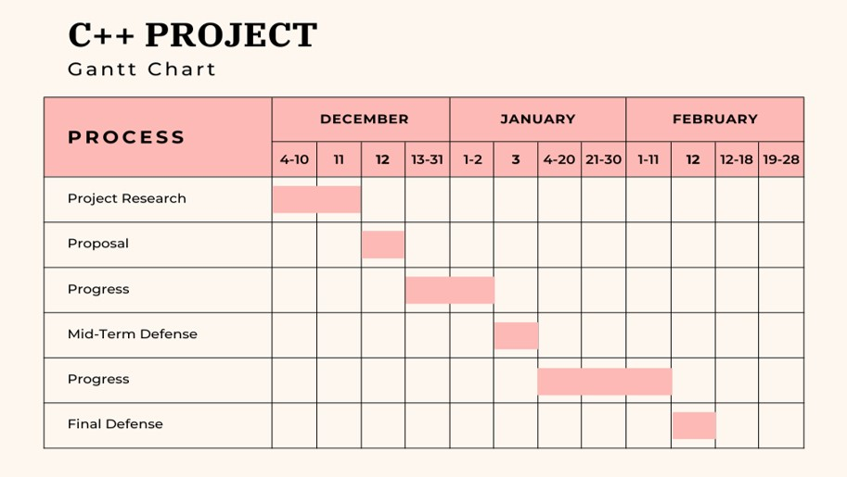
GANTT CHART

Slide 6
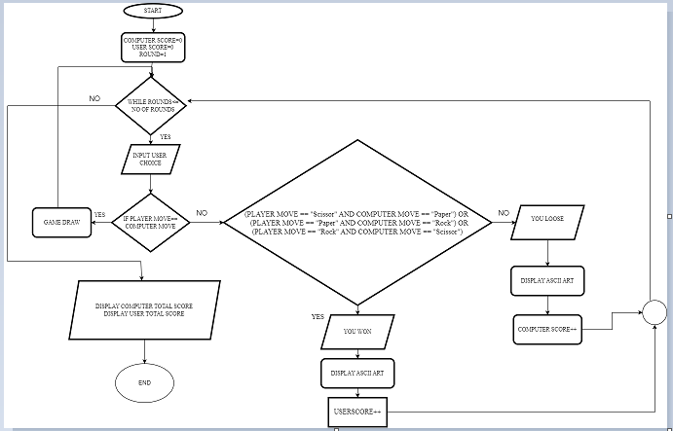
Flowchart

Slide 7
Conclusion
The game was successfully implemented in C++, with all of the key features working as intended.
The game provides a fun and interactive way for players to practice their decision-making skills.
The project served as an opportunity to learn and practice C++ programming concepts, such as functions, loops.
Overall, the "scissor, paper, rock" game was a successful project that can be enjoyed by players of all ages.

